Slide 1
Statistical Modeling: The Two Cultures by Leo Breiman presented by Jack Morris https://qdata.github.io/deep2Read/

Slide 2
https://qdata.github.io/deep2Read/
Roadmap
Data Modeling Culture [Statistics]
Algorithmic Modeling Culture [Machine Learning]
Principles of Statistical Learning
Summary + Leo’s Advice

Slide 3
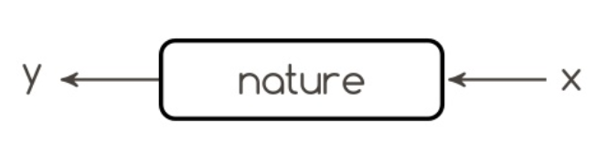

Slide 4
Two goals of statistics
Prediction:
To predict responses for future input variables
Information:
To extract some information about what nature is actually doing

Slide 5
The two cultures: Data models
Assume a stochastic model is actually happening inside the black box. This means that if we figure out the model, we can figure out what nature is doing! Popular tools: Linear regression, logistic regression, Cox model
Validation technique: examining residuals, testing model fit, etc.
Estimated population of statisticians (in 2001): 98%

Slide 6
The two cultures: Algorithmic models
We don’t know (or care) what’s happening inside the black box. It’s complex–and fundamentally unknowable. We just want to find some function f(x) that can predict y.
Popular tools: decision trees, neural networks
Validation technique: predictive accuracy
Estimated population of statisticians (in 2001): 2%

Slide 7

Jim Simons: The Ultimate Algorithmic Modelist
“I don’t know why planets orbit the sun. That doesn’t mean I can’t predict them.” –Jim Simons
net worth $15.5 billion

Slide 8
Roadmap
Data Modeling Culture [Statistics]
Algorithmic Modeling Culture [Machine Learning]
Principles of Statistical Learning
Summary + Leo’s Advice

Slide 9
Data Modeling Culture
As of the time of writing, most of the statistics field was focused on creating data models
Data models give statisticians a job
they require lots of data analysis to develop hypotheses about how nature is actually functioning... and then model it
data models extract information about the underlying mechanism producing the data

Slide 10
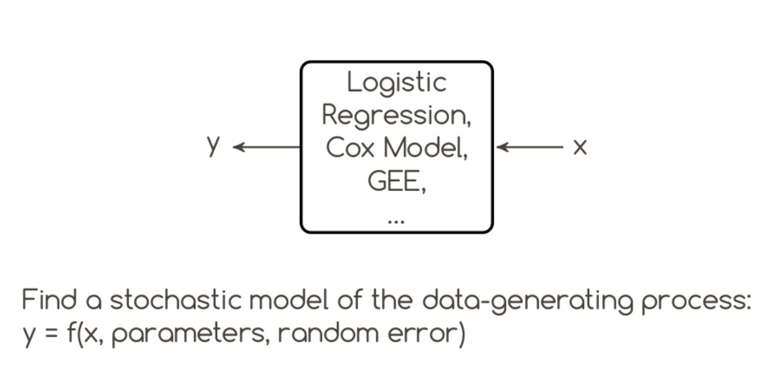
A typical data model

Slide 11
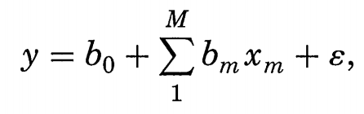
Data modeling: discerning the model that truly produces the data
a famous (also infamous) example:
y is a function of x with corresponding weights + random error
is the rent of some apartments really normally distributed? 🤔

Slide 12
Data modeling: typical assumptions
data are generated by a specific stochastic model
often assumes linearity
requires lots of data analysis + expert understanding

Slide 13
Data modeling: problems
Conclusions are made about the model (not about nature)
Assumptions are often (always?) violated
Often no real model evaluation– and once the model is released, its predictions are considered gospel
Focus is on analysis, not prediction
Data models always fail in areas like image and speech recognition

Slide 14
Roadmap
Data Modeling Culture [Statistics]
Algorithmic Modeling Culture [Machine Learning]
Principles of Statistical Learning
Summary + Leo’s Advice

Slide 15
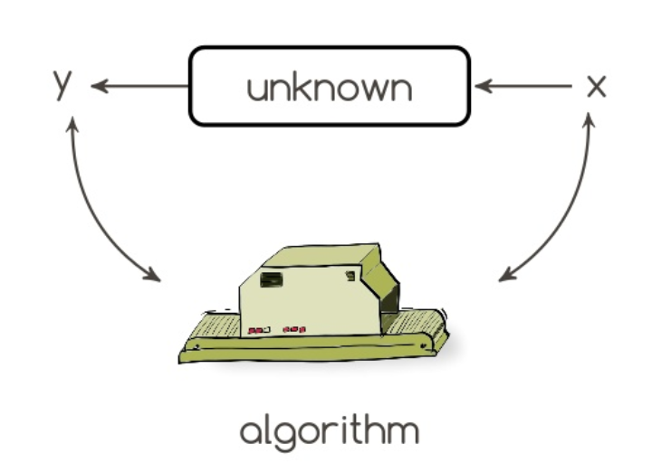
A singular goal
find a function f(X) that minimizes the loss L(Y, f(X)).
that’s it.

Slide 16
Algorithmic modeling: major differences
The target is not to find (or understand) the true data-generating mechanism– but to use an algorithm that imitates the mechanism as effectively as possible
This is machine learning culture
Summary: data modeling culture tries to find the true data-generating mechanism. Algorithmic modeling culture is comfortable approximating the mechanism as closely as possible.

Slide 17
Algorithmic modeling: major differences
The target is not to find (or understand) the true data-generating mechanism– but to use an algorithm that imitates the mechanism as effectively as possible
This is machine learning culture

Slide 18
Algorithmic vs. Data Modeling
Summary: data modeling culture tries to find the true data-generating mechanism. Algorithmic modeling culture is comfortable approximating the mechanism as closely as possible.
And once you relax your goal– and aspire solely for minimal prediction error– you open a door to a whole host of new algorithms...

Slide 19
Examples of Algorithmic Models
Boosting
Support Vector Machines
Neural networks
Random forests
Hidden markov models
Bayesian networks
... many other things

Slide 20
Random forests vs neural networks
“Random forests are A+ predictors” – in a comparison of 18 different classifiers (neural networks, CART, linear regression, nearest, neighbor, etc), random forests placed 1 out of 18 over four datasets
Fifth dataset: 16x16 pixel grayscale depictions of handwritten numerals
a neural net ...got 5.1% error (vs 6.2% for random forest)
remember this was 2001

Slide 21
Roadmap
Data Modeling Culture [Statistics]
Algorithmic Modeling Culture [Machine Learning]
Principles of Statistical Learning
Summary + Leo’s Advice

Slide 22
Three most important lessons from algorithmic modeling
Rashomon: there are many equally good models
Occam: there is a conflict between simplicity and accuracy
Bellman: dimensionality is a blessing and a curse

Slide 23
[1] Rashomon Effect
Rashomon is a Japanese movie where four witnesses see a crime from very different angles (but equal accuracy?)
Models can–and do–have totally different interpretations (@”Attention is not Explanation”)
Algorithmic modelers exploit the Rashomon effect by aggregating the predictions of many models
this is what Random Forests do

Slide 24
[2] Occam’s Razor
“The simplest solution is best” (or something like that) –Occam
(“Everything should be made as simple as possible, and no simpler” –Einstein)
There is a natural tradeoff between predictive accuracy and interpretability

Slide 25
Prediction vs. Interpetation
Models that are good at prediction are (often) more complex
models that are easy to interpret are simple, and therefore, worse predictors
Decision Trees are super intuitive, but can’t model complex processes
Random Forests have excellent prediction accuracy, but are basically impossible to interpret

Slide 26
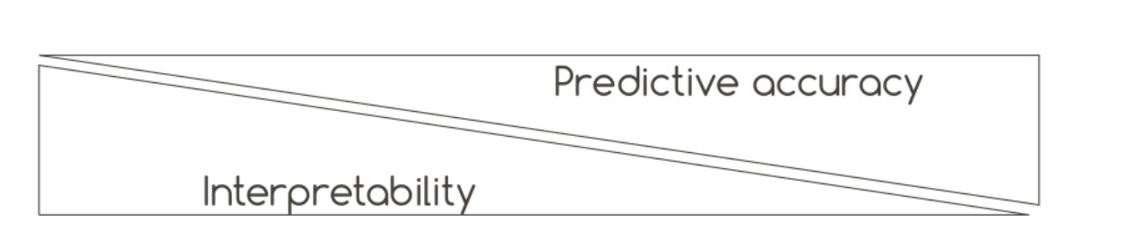
Prediction vs. Interpretation
Random Forests Neural Networks
Decision Trees
Logistic Regression

Slide 27
[3] Bellman and the Curse of Dimensionality
The higher the dimensionality of the data (# covariates), the more difficult it is to separate signal from noise
Common practice in data modeling: variable selection (done by experts or data analysts) and dimensionality reduction (PCA)
Common practice in algorithmic modeling: engineering extra features (more covariates!) to increase predictive accuracy

Slide 28
Roadmap
Data Modeling Culture [Statistics]
Algorithmic Modeling Culture [Machine Learning]
Principles of Statistical Learning
Summary + Leo’s Advice

Slide 29
Five pieces of advice for statistical analysis
Focus on finding a good solution to the problem. That’s what you’re paid for.
Live with the data before you plunge into modeling. (!)
Search for a model that gives a good solution, be it algorithmic or data.
Predictive accuracy on test sets is *the* criterion for how good your model is (at prediction).
Computers are an indispensable partner.

Slide 30
Information from a black box
“A model does not have to be simple to provide reliable information about the relationship between x and y... the goal is not interpretability, but accurate information.”

Slide 31
Conclusion
[1] Higher predictive accuracy --> more reliable information about the underlying data mechanism
weaker predictive accuracy --> questionable conclusions
[2] Algorithmic models can give better predictive accuracy than data models and provide better information about the underlying mechanism

